Slide 1
Computer Organization Principles
School of Software, Dalian University of Technology
Chi Lin (林驰)
chilin@mail.dlut.edu.cn

Slide 2
Great Reality #3: CPU Matters
Chances are you will never design your own processor.
It is intellectually interesting and important.
Understanding how the processor works aids in understanding how the overall computer system works.
Although few people design processors, many design hardware systems that contain processors.
You just might work on a processor design.
Are you ready ?

Slide 3
Chapter Five: Processor Architecture
Processor Organization (Architecture)
Processor Implementations (Realizations)
Instruction Pipeline (Optimizations)

Slide 4
Chapter Five: Processor Architecture
Processor Organization
Instruction Cycle
Instruction Pipeline

Slide 5
CPU Functionality
A central processing unit (CPU) is the hardware within a computer that carries out the instructions of a computer program by performing the basic arithmetical, logical, and input/output operations of the system.
Two typical components of a CPU are the arithmetic logic unit (ALU), which performs arithmetic and logical operations, and the control unit (CU), which extracts instructions from memory and decodes and executes them, calling on the ALU when necessary.

Slide 6
Main Functionality of CPU
Processing instructions
Perform an action
Control time

Slide 7
A Question
If you have a chance to design a CPU, what will you do ? Which part do you think is the most important ?

Slide 8
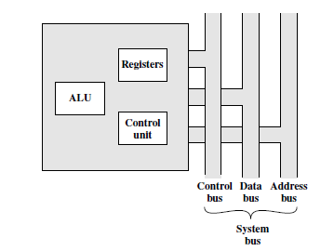
Traditional Processor Organization
Registers
ALU
Control Unit

Slide 9
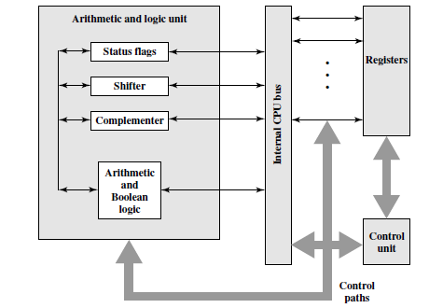
Internal Structure of CPU
Cooperation
Integration

Slide 10
An Insight to CPU
Visible-State (Register, Program State …)
Register Organization (Programmable Registers, Condition Codes, Memory…)
Instruction Set Design (Encodings, Concisely Design…)
Instructions Encodings (Encode vs Decode, Opcode, Oprands …)

Slide 11
Chap 5.1 Processor Organization
Programmer-Visible State
Register Organization
Y86 Instructions
Instructions Encodings

Slide 12
Chap 5.1 Processor Organization
Programmer-Visible State
Register Organization
Y86 Instructions
Instructions Encodings

Slide 13
Programmer Visible State
Each instruction in a Y86 program can read and modify some part of the processor state.
Programmer-visible state, where the “programmer” in this case is either someone writing programs in assembly code or a compiler generating machine-level code.

Slide 14
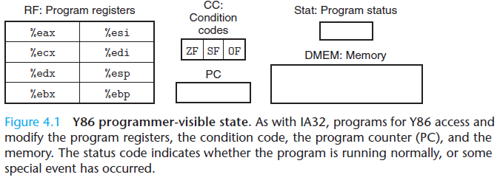
Programmer Visible State
Registers (For information manipulation)
Condition Codes (For instruction control)
Stat (Program status)

Slide 15
Eight program registers
%eax, %ecx, %edx, %ebx, %esi, %edi, %esp, and %ebp
Register %esp is used as a stack pointer by the push, pop, call, and return instructions.
Three single-bit condition codes, ZF, SF, and OF, storing information about the effect of the most recent arithmetic or logical instruction.

Slide 16
Memory
The memory is conceptually a large array of bytes, holding both program and data. Y86 programs reference memory locations using virtual addresses. A combination of hardware and operating system software translates these into the actual, or physical, addresses indicating where the values are actually stored in memory.

Slide 17
Program State
Stat
Normal Operations
Exceptions

Slide 18
Chap 5.1 Processor Organization
Programmer-Visiable State
Register Organization
Y86 Instructions
Instructions Encodings

Slide 19
Y86 Instructions
Which kind of instructions do you think is necessary to be included in your processor ISA ?
Data movement
Arithmetic & Logical calculations
Call & return
Push & pop

Slide 20
Instruction Set Requirements
Instruction range
Unique decoding
ISA (E.g. Instruction types, opcodes, operands)

Slide 21
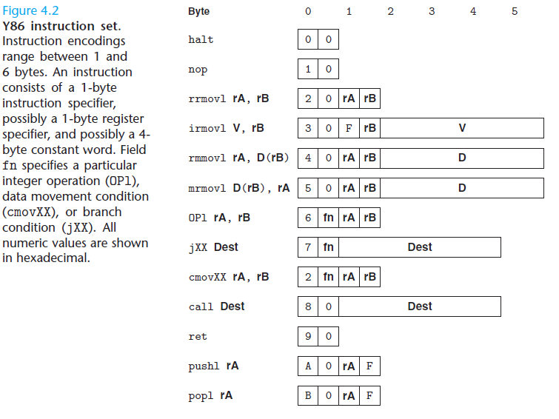
Y86 Instructions

Slide 22
Instruction Details
There are four integer operation instructions, shown in Figure 4.2 as OPl. These are addl, subl, andl, and xorl. They operate only on register data, whereas IA32 also allows operations on memory data. These instructions set the three condition codes ZF, SF, and OF (zero, sign, and overflow).

Slide 23
Instruction Details
The seven jump instructions (shown in Figure 4.2 as jXX) are jmp, jle, jl, je, jne, jge, and jg. Branches are taken according to the type of branch and the settings of the condition codes. The branch conditions are the same as with IA32 (Figure 3.12).

Slide 24
Instruction Details
There are six conditional move instructions (shown in Figure 4.2 as cmovXX): cmovle, cmovl, cmove, cmovne, cmovge, and cmovg. These have the same format as the register-register move instruction rrmovl, but the destination register is updated only if the condition codes satisfy the required constraints.
The call instruction pushes the return address on the stack and jumps to the destination address. The ret instruction returns from such a call.

Slide 25
Instruction Details
The pushl and popl instructions implement push and pop, just as they do in IA32.
The halt instruction stops instruction execution. IA32 has a comparable instruction, called hlt. IA32 application programs are not permitted to use this instruction, since it causes the entire system to suspend operation. For Y86, executing the halt instruction causes the processor to stop, with the status code set to HLT. (See Section 4.1.4.)

Slide 26
Y86 Instructions
4-byte data as the machine “word”
Addressing modes
Program Counter

Slide 27
Chap 5.1 Processor Organization
Programmer-Visiable State
Register Organization
Y86 Instructions
Y86 Instructions Encodings

Slide 28
Y86 Instructions Encodings
Each instruction requires between 1 and 6 bytes, depending on which fields are required.
Every instruction has an initial byte identifying the instruction type. This byte is split into two 4-bit parts: the high-order, or code, part, and the low-order, or function, part.

Slide 29
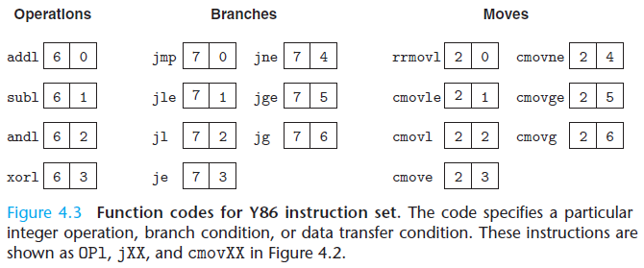
Function codes for Y86 Instruction Set

Slide 30
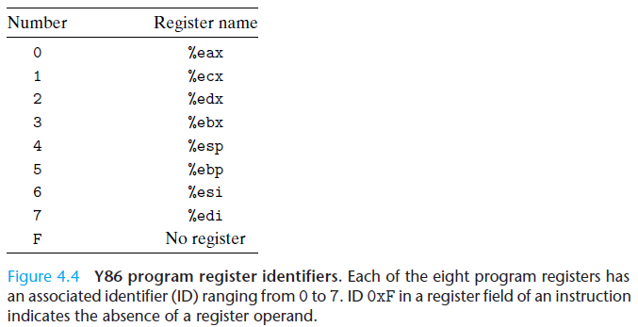
Register identifiers

Slide 31

Do you believe it?
After these four step are completed, will Y86 actually work? Will it execute the real IA32 program ???
Programmer-Visible State
Y86 Instructions Definition
Y86 Instruction Encoding

Slide 32
Y86 Programs

Slide 33

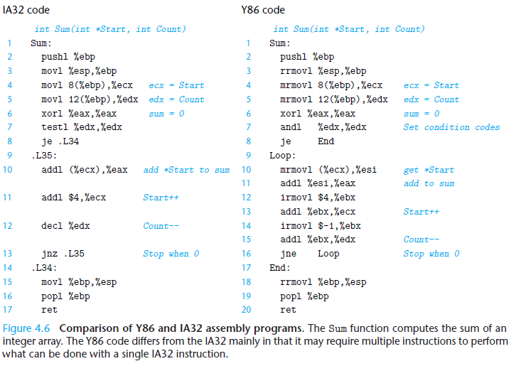
Comparison between IA32 & Y86

Slide 34
Oh yeah!
Our Y86 can proceed simple program.
But our problem is how to process the program ? We will solve it next class.

Slide 35
Homework
Review Chapter 4.1
Practice Problem 4.1-4.5
Suppose you are an expert computer designer, you are going to develop an calculator that can execute addition, subtraction, multiplication, division and exponential calculations, how will you design the instruction set ?

Slide 36
Thank You

